Slide 1

Organizational Behavior Course Model
OB Outcomes: Attitudes and Behaviors
Effort
Job Satisfaction
Absenteeism
Turnover
Stress
Workplace Violence
Organizational Citizenship Behavior and Commitment
Employee Theft
Safety and Accidents
Sexual Harassment
Grievances
Influenced by Managers Using
Application of Individual Differences
    Perceptions
    Attributions
    Attitude change
    Values
    Personality
Group Dynamics
Reward Systems
Job Design
Leadership

Slide 2

Motivation Illustration
Misconceptions about Motivation
*Current generation has no work ethic
* Some people are born “lazy”
* Most people are motivated by the same thing

Slide 3

Why is Motivation Important?
Under optimal conditions, effort can often be increased and sustained
Delegation without constant supervision is always necessary
Employees can become self-motivated
Motivated employees can provide competitive advantage by offering suggestions & working to satisfy customers

Slide 4

Bottom Line
Motivation is accomplishing things through the efforts of others. If you cannot do this, you will fail as a manager.

Slide 5
MAJOR THEORIES OF MOTIVATION
I. Need Approaches:
- Maslow’s Hierarchy of Needs
- Alderfer’s ERG Theory
- Herzberg’s Two Factor Theory
- McClelland’s Learned Needs Theory
II. Cognitive Approaches:
- Expectancy Theory
- Equity Theory/ Social Comparison
- Goal Setting Theory
III. REINFORCEMENT THEORY OR OPERANT CONDITIONING : How Rewards & Reinforcements Sustain Motivation Over Time
(Behavior Modification)

Slide 6



Job performance = f (ability X motivation X organizational support)

Slide 7
SELF- ACTUALIZATION
(using all of one’s abilities)
ESTEEM
(self and from others)
SOCIAL/AFFILIATION
SAFETY/SECURITY
PHYSIOLOGICAL
Maslow’s Hierarchy of Needs Model

Slide 8
“Issues” with Maslow’s Need Model
Businesses typically do well satisfying lower order needs.
Model stipulates that there are 5 needs and that the order is “fixed”. Research indicates some may only have 2-3 need hierarchy; others 5-6. The order may also be inverted and meeting needs outside of work not accounted for.
Model not developed from average employees

Slide 9
Alderfer’s ERG Theory
Need Growth Needs Need
Progression Regression
Relatedness Needs
Existence Needs
Notes:
4

Slide 10
Herzberg’s Theory Rests on 2 Assumptions
1.) Being satisfied with one’s job is equivalent to being motivated; “a satisfied worker is a motivated worker”
2.) Job satisfaction and dissatisfaction are separate concepts with unique determinants based on work with accountants and engineers

Slide 11

Herzberg’s 2-Factor Theory
Determinants of Job Dissatisfaction are Hygiene* Factors:
Pay, fringe benefits
Working conditions
Quality of supervision
Interpersonal relations
Job Environment Factors
* Poor hygiene can make you, sick, but good hygiene won’t necessarily make you healthy
Determinants of Job Satisfaction are Motivator Factors:
Work itself, responsibility
Advancement
Recognition
Job Content
Factors

Slide 12

Assessment of Herzberg
Contributions
1st to argue that job content/job design was important
Job enrichment (the work itself) as a job satisfaction strategy
Model appealing and easy to understand
Criticisms
May be “method-bound” by self-serving bias
Some individual
differences, like desire for pay, rejected as a motivator.
Also, not everyone wants an enriched job
Assumes satisfaction (presence of motivators) = motivation

Slide 13
WORK PREFERENCES OF PERSONS HIGH IN NEED FOR ACHIEVEMENT, AFFILIATION, AND POWER
INDIVIDUAL NEED WORK PREFERENCES JOB EXAMPLE
- Individual responsibility
- Challenging but achievable goals
- Feedback on performance
Field sales person with challenging quota and opportunity to earn individual bonus
High need for achievement
- Interpersonal relationships
- Opportunities to communicate
Customer service representative; member of work unit subject to group wage bonus plan
High need for affiliation
Formal position of supervisory responsibility; appointment as head of special task force or committee
High need for power
- Control over other persons
- Attention
- Recognition

Slide 14
A Comparison of Internal Need Theories of Motivation
Maslow’s Alderfer’s Herzberg’s McClelland’s
Hierarchy ERG Two Factor Acquired
of Needs Theory Theory Needs Theory
Self- Achievement
Actualization Growth
Motivator
Esteem Power
Relatedness
Belonging Affiliation
Hygiene
Security
Existence
Physiological
Notes:
12

Slide 15

THE GOALS OF COGNITIVE THEORIES ARE TO EXPLAIN THOUGHTS ABOUT EFFORT:
1.) the decision to expend effort
2.) the level of effort to exert
3.) how effort can be made to persist over time

Slide 16
Expectancy Theory
Involves 3 cognitions/perceptions:
1. Expectancy - the perceived probability that effort will
lead to task performance. E link
2. Instrumentality - the perceived probability that
performance will lead to rewards. I link
3. Valence - the anticipated value of a particular
outcome to an individual.
Effort Performance Rewards or
Outcomes
E link I link
Notes:
13

Slide 17
EXPECTANCY THEORY
(Text adds “Personal Goals” after Outcomes)
Instrumentality
E P Expectancy or P O Theory Valence
What is the probability What is the probability What value do I place
that I can perform at that my good performance on the potential
the required level will lead to outcomes? outcomes? (see
if I try? next slide)
Effort Performance Outcomes
Notes:
14

Slide 18
EXPECTANCY THEORY
Level of
Performance
or
Production
Money (+9)
Promotion (+6)
Job Satisfaction (+1)
Peer
Disapproval (-8)
Motivation to
Exert
Effort
E
Link
I
Link

Slide 19
Partial Test of Expectancy Theory as Used in Simulation
Rewards or Outcomes
-Earn high grades
-Feeling of accomplishment
-Learning something
practical
Effort
E

Slide 20
Implications for Managers
    Need to offer employees valued rewards (high valences)
    Need to insure that if people are willing to put forth effort that you help them succeed. Maintain the E link (Provide tools, info, support)
    Need to make sure that you follow through with reward system that is tied to performance. Maintain the I link (Differential rewards for performance)

Slide 21
What is the basis of equity theory?
…the thinking process by which one makes a decision to exert effort is a function of social comparison
Based on individual perceptions of outcomes (what your receive from expending effort to complete a task), job inputs (what you bring or contribute to the task) and perceptions of a referent person.

Slide 22

Equity Theory: The decision to exert effort is a function
of social comparison
Involves 3 relevant perceptions:
1. Perceptions of outcomes received from performing a task.
(e.g., pay)
2. Perceptions of inputs required to perform a task.
3. Perceptions of the outcomes and inputs of a REFERENCE
PERSON.
If: Outcomes _{Self} Outcomes _{Reference Person}
=
Inputs _{Self} Inputs _{Reference Person}
Then equity exists.
Notes:
15

Slide 23
How does equity theory work?
Employees mentally construct outcome-to-input ratios for themselves and their referent other and “socially compare”
If equity exists, you experience no tension and persist at your current level of effort
When Outcome _{Self} =/= Outcome _{Reference person}
Input _{Self} Input _{Reference person}
Tension is created and employees are “motivated” to restore equity

Slide 24
Equity Theory
Equitable Situation:
Outcomes _{Self} = Outcomes _{Reference Person}
Job Inputs _{Self} Job Inputs _{Reference Person}
Inequitable Situations:
A. Under-reward or “Cheated” (from Self’s point of view)
Outcomes/Inputs _{Self} 4/5 < Outcomes/Inputs _{Reference Person} 5/5
B. Over-reward or “Guilty” (from Self’s point of view)
Outcomes/Inputs _{Self} 5/4 > Outcomes/Inputs _{Reference Person} 5/5
C. Either way, a person is “motivated” to restore equity with R.P.
Notes:
16

Slide 25
Examples
You Ref. Person Ways to Reduce Tension
3 < 4 Outcomes a. increase outcomes like ask for
4 4 Inputs a raise (Δ Your outcome 3 to a 4)
b. reduce job inputs like ↓ effort
(Δ Your input 4 to a 3)
“Under-reward” (What YOU is, from You’s perspective)
4 > 3 Outcomes a. increase job inputs like work
3 3 Inputs harder (Δ Your input 3 to a 4)
b. reduce outcomes
? refuse pay raise
? decline promotion, unrealistic
“Over-reward Condition” (What YOU is, from You’s perspective)

Slide 26

Restoring Equity
Under-reward:
Increase outcomes
Reduce inputs
Over-reward:
Increase inputs
Reduce Outcomes (?)
-criticism of equity theory
Other Options:
Leave situation
Alter perceptions
Change reference person
Notes:
17

Slide 27
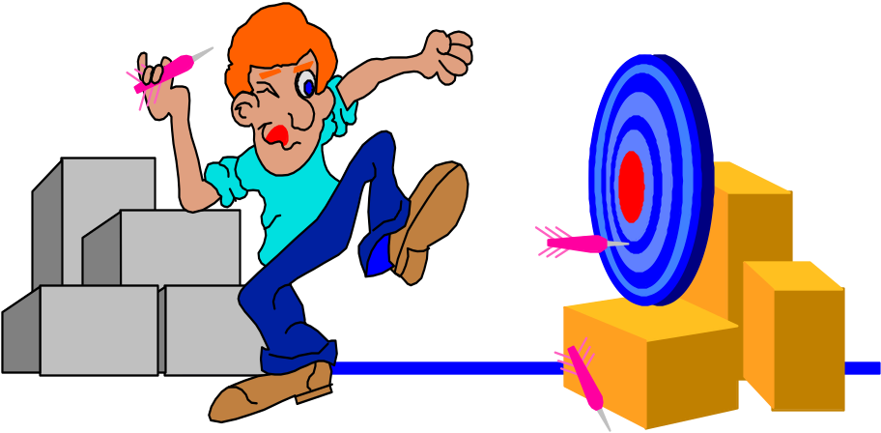
REASONING BEHIND GOAL SETTING
Direction - specific goals direct your focus to relevant activities
Effort - need to devote more intense levels of effort toward difficult goals - assumes people are goal driven
Persistence - specific, difficult goals encourage you to persist longer at a task than would be the case without
such goals
Only possible exception is high “uncertainty avoidance” cultures.
Notes:
18

Slide 28
Representative Goal Setting Study
Unexcused Quality
Goal Concept & Sample Item Effort Absenteeism Defects
Goal Challenge- 4 items
(my full range of ability must + - -
be used to reach my goals)
Goal Clarity- 5 items
(The goals for my job are easy + - -
to understand)
Goal Feedback- 6 items
(The feedback I receive + - -
concerning my goal progress
is helpful)
Goal Participation- 4 items
(My supervisor asks my opinion not - -
when goals are set) related
Key: + = positively related, - = negatively related

Slide 29
MAJOR THEORIES OF MOTIVATION
II. Cognitive Approaches:
- Expectancy Theory
- Equity Theory/ Social Comparison
- Goal Setting Theory
III. REINFORCEMENT THEORY OR OPERANT CONDITIONING : How Rewards & Reinforcements Sustain Motivation Over Time (Behavior Modification)
●May best address how motivation can be made to persist over time
● Behaviors like effort can be sustained or changed by experiencing or observing reinforcements

Slide 30
Reinforcement Theory of Motivation
Some view as an explanation of motivation; others limit it to how motivation is sustained over time.
Does not have to rely on needs, perceptions or cognitions. Managers can design work environment to provide “reinforcers” that strengthen desired behaviors & weaken undesired behaviors. “Motivation is a function of the environment”.
Others allow for cognitions in that people can observe rewards and punishments applied to others. Called social learning or vicarious learning.

Slide 31

Motivation as a Form of Learning:
The Law of Effect
Behavior that leads toward rewards tends to be repeated
Behavior that tends to lead toward no rewards or toward punishment tends to be avoided
The type of reinforcer & the timing (schedule) of reinforcement are key

Slide 32
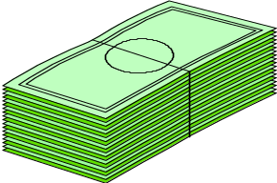
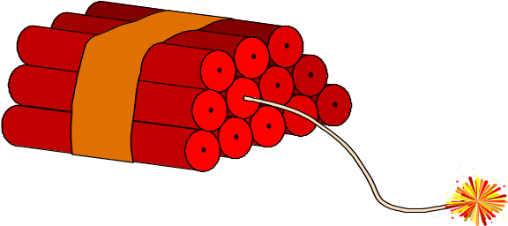
Reinforcers Which Strengthen Behavior: What managers can do to increase the probability of behavior in the future
a. Positive reinforcement--rewards contingent on exhibiting the correct behavior.
b. Avoidance Learning—withholding something unpleasant when a desired behavior is engaged in (e.g., an annoying alarm is avoided when a machine is used properly, not operating in reverse). Or, using social learning, noticing how engaging in some behavior avoids an unpleasant outcome (e.g., arrive on time and the boss does not yell). Text: Negative reinforcement
Notes:
19

Slide 33

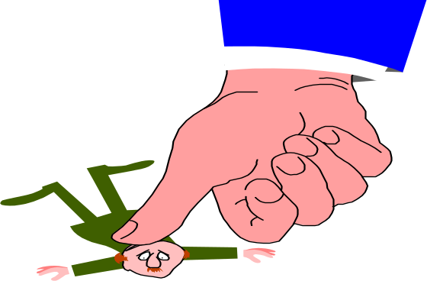
Reinforcers Which Weaken Behavior: What managers can do to decrease the probability of behavior in the future
a. Punishment--administering unpleasant consequences
following an undesirable behavior.
b. Extinction--when there are no rewards for a
behavior which was previously rewarded.
Notes:
20

Slide 34
Timing of Reinforcement
a. How quickly reinforcers work depends on their timing
b. Continuous. Used to “shape” new behaviors
c. But continuous reinforcement is impractical
1. Costly
2. Not as effective in sustaining behavior over time

Slide 35
Partial Reinforcement Schedules
1. Based on passage of time
Fixed Interval- Reinforcer given after set period of time.
Ex.: Weekly pay.
Variable Interval- Reinforcer given randomly with passage of time.
Ex.: Surprise bonus based on time.
2. Based on behavior exhibited by the employee (team)
Fixed Ratio- Reinforcers based on behaviors.
Ex.: Piece rate pay.
Variable Ratio- Reinforcers applied randomly after exhibition of behaviors.
Ex.: A company vacation to Hawaii for all employees after a new contract landed; spot bonuses.

Slide 36
Schedules of Reinforcement
Spacing or Timing of Reinforcer
Fixed Variable
Based on
# of behaviors
exhibited Fixed Ratio Variable Ratio
(ratio) -piece rate -door to door sales
Basis for
determining Based on Fixed Interval Variable Interval
frequency of passage -weekly -Occasional
reinforcer of time paycheck praise by boss
(interval)
Which schedule sustains behavior the longest?
Notes:
21

Slide 37
Summary of Motivation Theories
A. View all these approaches as a “bag of tricks.” Alternatives to choose from, remembering that all are not compatible.
B. Judge whether you believe each “works.” Rely on the scientific data presented, your experiences, and your common sense.
C. Evaluate your prospects for successfully implementing each one--we all vary in our interpersonal skills and ability to render social rewards sincerely.
D. The question is not whether each of these approaches to motivation works, but where and when they work best.

